Slide 1
CSU33014 Concurrent Systems I
Dr. David Gregg
Trinity College Dublin

Slide 2
Objectives
The goal of this course is to learn the basics of practical parallel programming with the goal of achieving real speedups on multi-core systems. This is best done with a good understanding of the architecture.

Slide 3
Lab Work
Linux server with four eight core processors
  32 cores
  stoker.scss.tcd.ie

Slide 4
Why learn this stuff?
You are computer scientists
  So you should understand
You will program parallel computers
  Computers are now parallel
You will have to make higher-level decisions about using parallel machines
  Is parallelism the solution to my problem?
You may have to design parallel architectures
  I thought I would never have to, but I did
The ideas are transferable to other domains

Slide 5
Why write a parallel program?
For software engineering reasons
  Many programs simulate the real world
  The real world is parallel
    E.g. Computer games
Because your problem is distributed
  May involve multiple sites
    E.g. mobile phones, PDAs, sensors
  No choice
    there must be multiple computers

Slide 6
Why write a parallel program?
To solve your problem more quickly
  Divide work across parallel units
  Main focus of this course
But normally we say that you shouldn’t worry about running speed
  At least until you discover it is a problem
  But certain types of applications benefit a lot from speed optimizations

Slide 7
Why write a parallel program?
Parallelizing a program is a speed optimization like any other
Some parallelization is automatic
  By compiler or processor itself
  This is easy and good
  But limitations on what can be done automatically

Slide 8
Why write a parallel program?
Biggest speedups come from writing your own parallel program
  This can be difficult and error prone
  Programmer time is expensive
  Errors may be even more expensive
    Nuclear power stations explode
    Wrong leg is amputated due to database bug
  You shouldn’t rush to write a parallel program just because you are using a parallel compute

Slide 9
Why write a parallel program?
Parallelizing a program is a speed optimization like any other
  Consider it in the context of other speed optimizations
  Use the best algorithm & data structure
  Make sure to enable the compiler optimizations
  Perhaps consider small code changes to key loops

Slide 10
Why write a parallel program?
Many programs are wildly inefficient
  No serious attempt to make them fast
    And rightly so!
  It’s usually pretty easy to get a factor of two speedup on most programs with simple optimizations
    This is the very most we can expect from parallelizing on a dual-core processor
    Even on 16 cores, a speedup of 5-6 might be good

Slide 11
Why write a parallel program?
But sometimes you need more speed
  Have a very efficient program
    But still not fast enough
  Parallel program will give more speed
Some apps never fast enough
  Games
  Image processing
  Scientific & engineering simulations
  Code breaking

Slide 12
Why write a parallel program?
Parallelism is also tied to energy
  A parallel computer with several small processors may be more energy efficient than a similar machine with one super fast processor

Slide 13
Never forget Amdahl
  “For over a decade, prophets have voiced the contention that the organization of a single computer has reached its limits and that truly significant advances can only be made by the interconnection of a multiplicity of computers in such a manner as to permit cooperative solution…. Demonstration is made of the continued validity of the single processor approach”
  - Gene Myron Amdahl, 1967

Slide 14
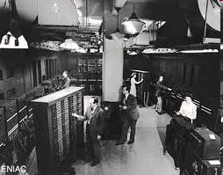
Or J. Presper Eckert
J. Presper
Eckert

Slide 15
J. Presper Eckert
“Any steps that are programmed by the operator, who sets up the machine, should be set up only in a serial fashion. It has been shown over and over again that any departure from this procedure results in a system that is much too complicated to use.”
J. P. Eckert 1946

Slide 16
Long long ago in a distant time of single-core computer architecture
Notes borrowed from
David Patterson
Electrical Engineering and Computer Sciences
University of California, Berkeley

Slide 17
Crossroads 2005: Conventional Wisdom in Comp. Arch
Old Conventional Wisdom (CW): Power is free, Transistors expensive
New Conventional Wisdom: “Power wall” Power expensive, transistors free
(Can put more on chip than can afford to turn on)
Old CW: Sufficiently increasing Instruction Level Parallelism via compilers, innovation (Out-of-order, speculation, VLIW, …)
New CW: “ILP wall” law of diminishing returns on more HW for ILP
Old CW: Multiplies are slow, Memory access is fast
New CW: “Memory wall” Memory slow, multiplies fast
(200 clock cycles to DRAM memory, 4 clocks for multiply)
Old CW: Uniprocessor performance 2X / 1.5 yrs
New CW: Power Wall + ILP Wall + Memory Wall = Brick Wall
  Uniprocessor performance now 2X / 5(?) yrs
⇒ Sea change in chip design: multiple “cores”
(2X processors per chip / ~ 2 years)
    More simpler processors are more power efficient

Slide 18
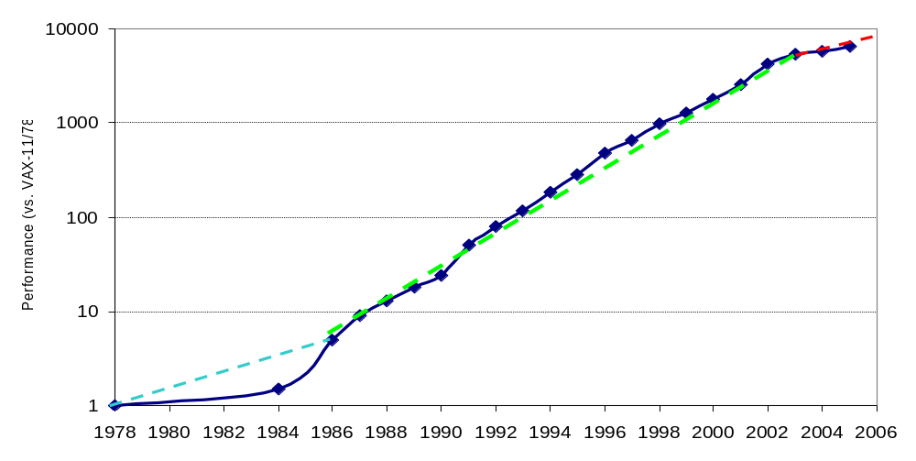
Crossroads: Uniprocessor Performance
From Hennessy and Patterson, Computer Architecture: A Quantitative Approach, 4th edition, October, 2006
VAX : 25%/year 1978 to 1986
RISC + x86: 52%/year 1986 to 2002

Slide 19
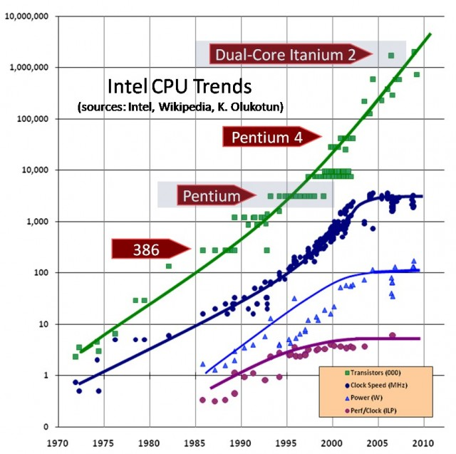
The death of CPU scaling: From one core to many — and why we’re still stuck - Joel Hruska

Slide 20
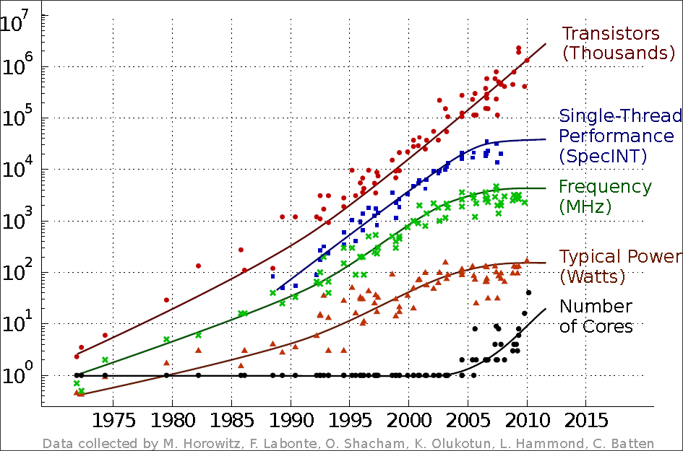
DATA PROCESSING IN EXASCALE-CLASS COMPUTER SYSTEMS - Chuck Moore
Original data collected and plotted by M. Horowitz, F. Labonte, O. Shacham, K. Olukotun, L. Hammond and C. Batten. Dotted line extrapolations by C. Moore

Slide 21
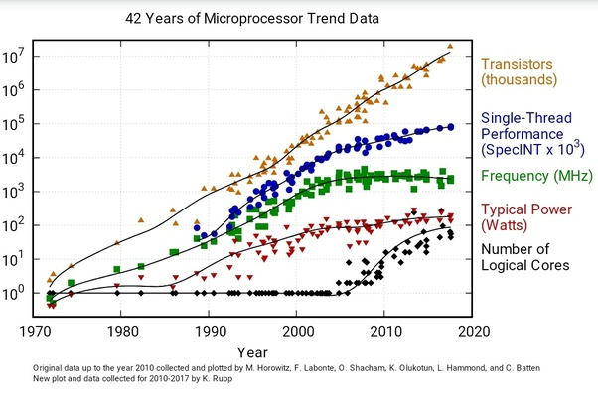

Slide 22
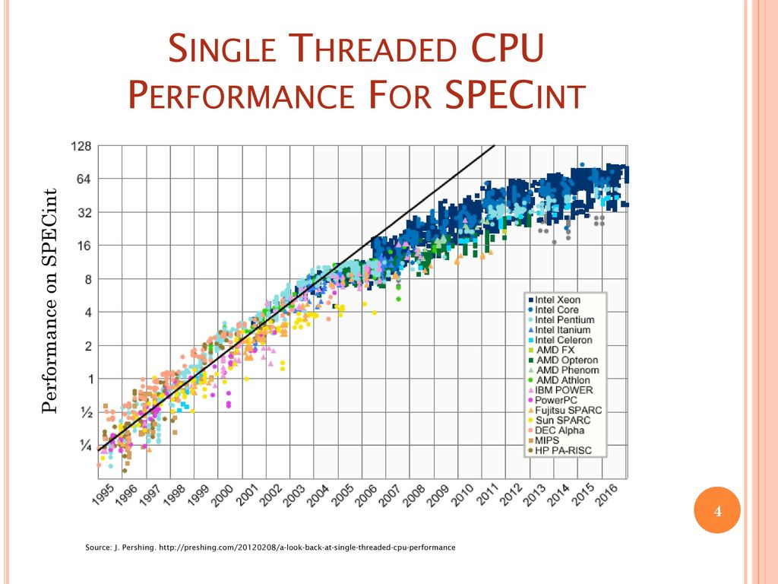

Slide 23
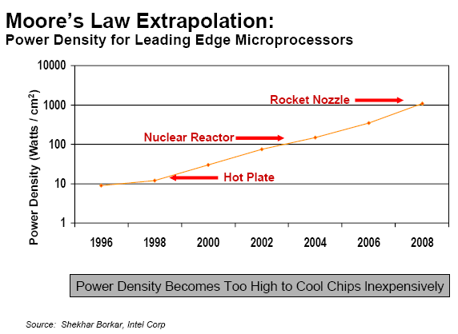
Limiting Force: Power Density
1/19/2011
CS252-S11, Lecture 01

Slide 24
Some of the key performance issues
Use an efficient algorithm
  and data structures
  with efficient implementation
Locality
  It is difficult to underestimate the importance of locality
  But it is almost invisible to the programmer
Parallelism
  Multiple threads (everyone talks about this)
  Vector parallelism (just as important)

Slide 25
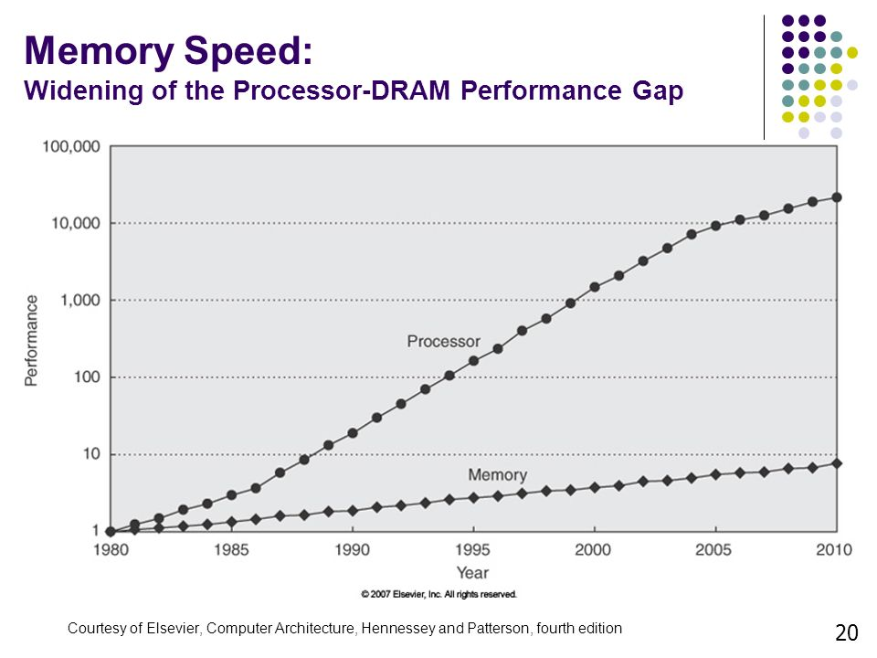
The “memory wall”

Slide 26
The Principle of Locality
The Principle of Locality:
  Programs access a relatively small portion of the address space
  at any instant of time.
Two Different Types of Locality:
  Temporal Locality (Locality in Time): If an item is referenced,
  it will tend to be referenced again soon (e.g., loops, reuse)
  Spatial Locality (Locality in Space): If an item is referenced,
  items whose addresses are close by tend to be referenced soon
  (e.g., straight-line code, array access)
Last 30 years, HW relied on locality for memory perf.
P
$
MEM
Notes:
The principle of locality states that programs access a relatively small portion of the address space at any instant of time.
This is kind of like in real life, we all have a lot of friends. But at any given time most of us can only keep in touch with a small group of them.
There are two different types of locality: Temporal and Spatial. Temporal locality is the locality in time which says if an item is referenced, it will tend to be referenced again soon.
This is like saying if you just talk to one of your friends, it is likely that you will talk to him or her again soon.
This makes sense. For example, if you just have lunch with a friend, you may say, let’s go to the ball game this Sunday. So you will talk to him again soon.
Spatial locality is the locality in space. It says if an item is referenced, items whose addresses are close by tend to be referenced soon.
Once again, using our analogy. We can usually divide our friends into groups. Like friends from high school, friends from work, friends from home.
Let’s say you just talk to one of your friends from high school and she may say something like: “So did you hear so and so just won the lottery.”
You probably will say NO, I better give him a call and find out more.
So this is an example of spatial locality. You just talked to a friend from your high school days. As a result, you end up talking to another high school friend. Or at least in this case, you hope he still remember you are his friend.
+3 = 10 min. (X:50)

Slide 27
Levels of the Memory Hierarchy
Capacity
Access Time
Cost
Staging
Xfer Unit
CPU Registers
100s Bytes
300 – 500 ps (0.3-0.5 ns)
Registers
Upper Level
Instr. Operands
prog./compiler
1-8 bytes
faster
L1 and L2 Cache
10s-100s K Bytes
~1 ns - ~10 ns
$1000s/ GByte
L1 Cache
Blocks
cache cntl
32-64 bytes
L2 Cache
cache cntl
64-128 bytes
Main Memory
G Bytes
80ns- 200ns
~ $100/ GByte
Blocks
Memory
Pages
OS
4K-8K bytes
Disk
10s T Bytes, 10 ms
(10,000,000 ns)
~ $1 / GByte
Disk
Files
user/operator
Mbytes
Larger
Tape
infinite
sec-min
~$1 / GByte
Tape
Lower Level

Slide 28
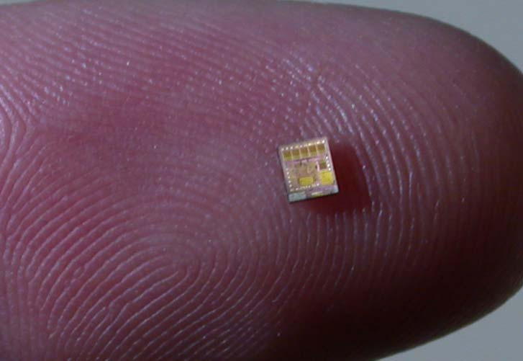
It’s not just about bigger and faster!
The world changed in 2005 with multicore processors
  “I for one welcome our new multicore overlords”
But that’s not the end of the story…

Slide 29
The Teeny Years
Since 2010 computer architecture has been changing
Are these changes really fundamental?
  Or does it just seem that way because we’re living through it?
  It’s difficult to say
Changes are being driven by a mix of…
  Computer hardware technology
  Applications
Applications are really important
  We design computers to run particular types of applications well
  There is no such thing as a fast computer
  The question is always, what type of applications can it run fast?
  If the type of important applications change, we design new computers

Slide 30
Some changes in the teenies
Computing has moved off the desktop
Part of computing has moved to the cloud
  Computing in big centralized facilities
  It sometimes seems almost like a trip back to the 1960s
Part of computing has moved to mobile devices
  Since the 1970s there has been lots of embedded computing
    In cars, TVs, washing machines, factories
  But now people are carrying their computer with them
  Is it like the microcomputer revolution all over again?
Computing continues to become smaller and cheaper
  Doubling of transistors on a chip every 18-24 months
  Relentless falling in the cost of computing capacity
  Falling costs allow better and more powerful computers in more devices
  Which has helped to move computing from the desktop to mobile devices

Slide 31
Some changes in the teenies
Changes in types of applications
We live in a time of self surveilance
  People upload huge amounts of data about themselves
  Huge amounts of data available unlike at any time before
    E.g. Compared to Staatssicherheitsdienst in German Democratic Republic
  Falling computing costs make it feasible to process that data
  Makes new types of applications possible
Computers are untethered from the desktop
  Computers move around
  They can collect data from cameras, microphones, GPS
  New data available to be processed
  Falling computing costs make it feasible to process that data
  Makes new types of applications possible

Slide 32
Some recent changes
Developments in AI
Deep neural networks are really good at some tasks
  Especially image processing
  Train a neural network rather than writing a program
  Enables much more sophisticated analysis of non-text data
    E.g. The pictures of that night out that you upload
  Also enables mobile autonomous computing
    Especially drones, cars
  Neural networks require HUGE amounts of processing capacity

